Slide 1
Group 27
Deliverable 2 Presentation
Bryan Baek
Brendan Bessel
Kalabe Mulugeta
Josiah Tillett
Xinbo Yang

Slide 2
Functional Requirements
Functional Requirements
Report Generation - Process Oriented
The system will generate a daily report that will allow managers to evaluate when an employee has punched in or out
The system will generate a report at the end of the pay period that will allow the manager to see how many regular, overtime, and holiday hours each employee has worked
2. Employee Search - Process Oriented
The system must allow the manager to search for an employee based on name
The system must allow the manager to search for an employee based on SS number
The system must allow the manager to search for an employee based on Employee number
3. Edit - Process Oriented
The system must allow the manager to manually edit an employee’s, personal information schedule, hours worked, and punch times
4. Report Storage - Information Oriented
The system will store all generated reports
The system will store manually entered information

Slide 3
Nonfunctional Requirements
Operational
The system must be able to function through user-facing devices networked to a central controller.
2. Performance
The system must support multiple kiosks at multiple locations.
The system must be able to function 24 hours a day.
3. Security
Employees must use a keycard/pin number/thumbprint scan to clock in or out
The system will only allow a manager with an access code/thumbprint scan to make edits to employee information
Employee pin numbers will not be made available to managers
4. Cultural and Political
Employee information will not be sold or used outside of the company in any way
The system will only be available in English

Slide 4
Interview Summary - Chelsea Passante, Administrator
Office gets hectic when multiple people need to notify the manager of their arrival
Due to the lack of an automated punch-in system, the manager must always multi-task
An estimated 20 min-1hr wasted on double checking employee hours daily
Employees are also fed up with this process because it forces them to show up earlier to work to clock in.
Employees don’t have a positive sentiment towards the company as they have been asking for an automated timesheet and payroll system for years
Employees come in to argue over timesheets fairly regularly
Distracting from other duties
General decrease in employee satisfaction and efficiency

Slide 5
Interview Summary - Shalonda Williams, Non Employee
Accountability needs to be present in the system
New system will reduce arguments between managers and employees over timesheets
Employees shouldn’t have the ability to abuse the system for their own gain
Improving the system will:
Hold employees accountable
Reduce the workload for supervisors
Shorten the time needed to solve issues

Slide 6
Interview Summary - Mark Reed, Ramp Agent/Lead
The miscalculation of employee hours was a constant issue
Supervisors forget to punch people in or out on an almost daily basis
Wanted a system to be implemented that would ensure the correct payment amount
Coworkers hate current system and have been requesting a change for 2 years
Abusing of system from supervisors
Issue with time conflicts eventually had to be resolved by corporate
Promotion from Ramp agent to Lead didn’t change timesheet experience

Slide 7
Observation Notes:
Process Description: The timekeeping process is done 4 times daily as managers must clock in as well as clock out their employees. The manager opens up the web interface and enters each employee's name and manually clocks them in or out depending on the time. If the manager is on a call or busy on the floor then they must make a mental note of who came and checked in and input them into the system with the correct time once they go back to their desk. Managers also must clock in and out employees when they go on their lunch break in order to ensure they are only taking the allotted 30 minutes.
Notes:
The process is visibly irritating to the manager and employee
The process forces the manager to multi-task
The process wastes a lot of managerial time and effort
High probability of human error
System has many places for conflict

Slide 8
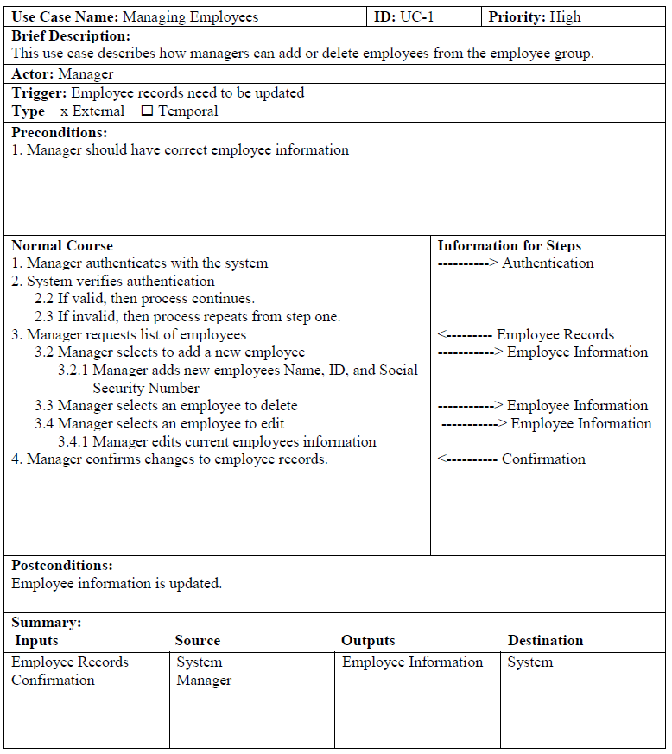
Use Case-1 Managing Employees

Slide 9
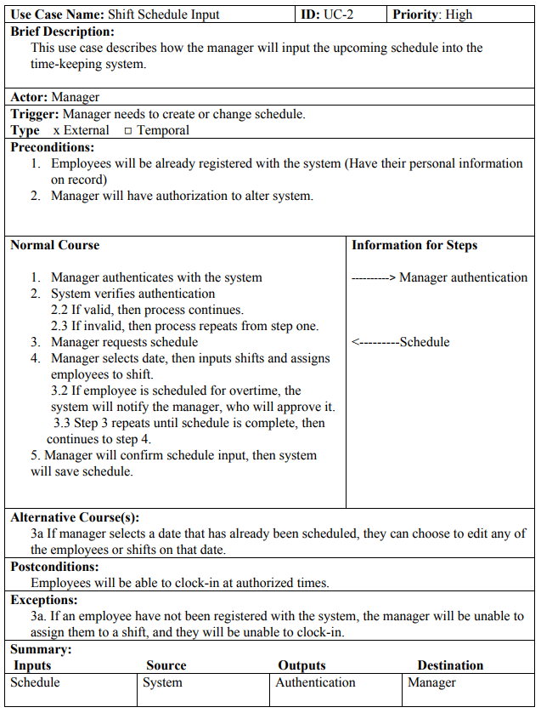
Use Case-2 Shift Schedule Input

Slide 10
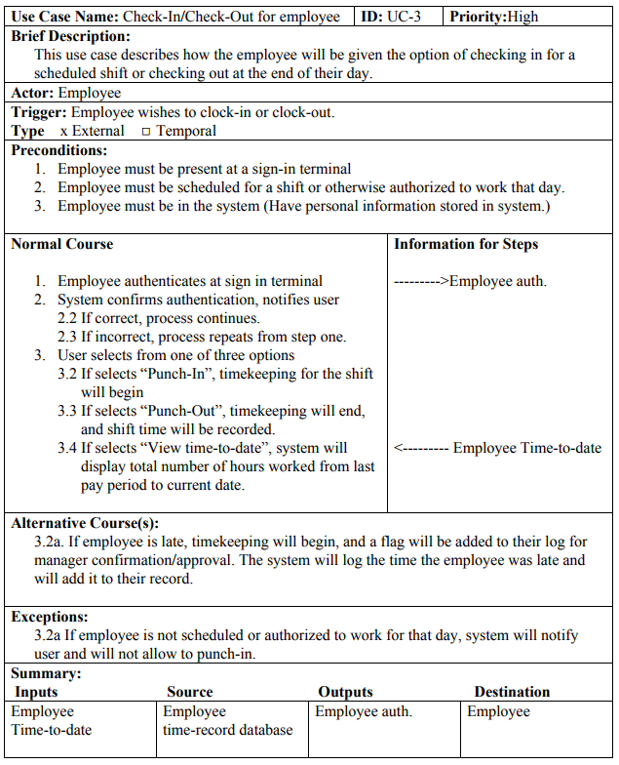
Use Case-3 Check-In/ Check-Out for Employees

Slide 11
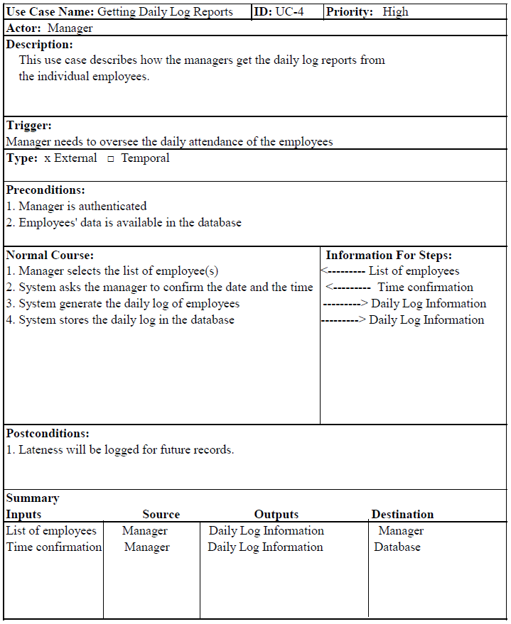
Use Case-4 Daily Log Reports

Slide 12
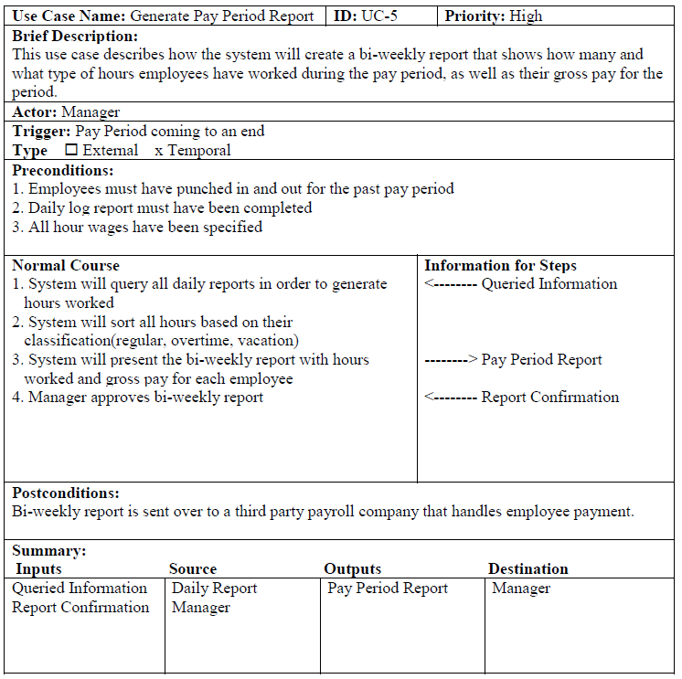
Use Case- 5
Pay Period Report

